Slide 1

The Gemini
Education Support System
For Universities, Colleges & Schools

Slide 2

About The Gemini University ERP
The Gemini University ERP (Enterprise Resource Planning) is more of a long-term commitment than the integrated and specialized software solution for any educational institution / University for providing students, faculty, and staff with highly effective tools to help them support and improvise on learning, discovery, and engagement. University ERP is primarily an initiative to replace universities administrative computing systems with a new integrated system. The processes that will be affected by the ERP implementation shall include Admission, Academics, Examination, Human Resource Management System, Financial Accounting, Budgeting, Research and many other areas. It provides for an effective Decision Support System to manage the entire operations and helps in taking timely decisions. Implementing university ERP should thus be an ideal choice in improving and expanding student and faculty services in any university or educational institution. University ERP supports institutions of all sizes and types as an integrated suite of proven, scalable, enterprise-wide application on a single database.

Slide 3

Major Objective:
Encourage competition in education system to computerize
the core departments and functions of the university to
maintain efficient and faster movement of information.
To computerize the examination processes and declare the results well in time while maintaining utmost confidentiality.
To computerize the Student data and enable the University to issue smart cards so that single identity can be maintained. It also helps in making campus more safe & secure for its students and others.
Improve utilization of technology and information systems in academic and administrative processes.

Slide 4

Key Features:
Centralized Web Based System
Availability of Real-time Business Information at all levels.
Consistent & highly Secured System.
Provides Effective Decision Support System (DSS) that helps in Timely Decision Making.
Faster and Automatic Report Generation.
Helps in Reducing Paperwork and Manual Filing and Record Keeping
Productivity Enhancement for Staff as Well as Students Due to Instant Availability of Critical Information.
Highly Interactive & User Friendly Interface
Highly secure with multiple level checks and user authentication
Exporting of reports to MS-Word, MS-Excel, PDF documents
Ensures Better Coordination and Workflow Between Departments.

Slide 5


Slide 6
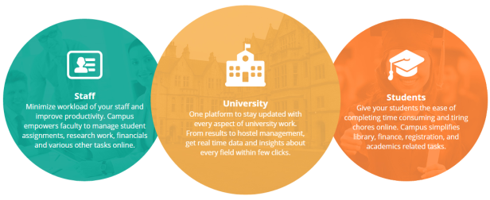

Slide 7


Benefits To Management :
Availability of real-time information.
Easy command, control and communication.
Budget control system.
Financial planning.
Paper less transactions.
Digital Data with consolidated reports.
Easy circulation of notices or events.
Employee Management Systems (attendance, work load and leave management).
IMS reports assist decision support for management to plan, implement and manage changes.
Do not need any change in current infrastructure.
Academic Calendar
D.R.R. (Daily Report Register)
Faculty + Student Logs
Library Book Searching & Reservation
Student Listing
Faculty Listing
Download Manager
News Manager
Training & Placement Management

Slide 8

Benefits to Students:
Get easily connected with the alumni
Better access to library Books and other references
Students can view Activity Calendar, Notices and News
Bar Code enabled I-Card for quick library book issue and returns
Better flow of information regarding institutes calendar, homework, assignments & announcements
Campus News
Fees Module
Due Fees Report
Fees Invoice
Fees Deposited
Attendance Record
Academic Time Table
Exam Time Table
Book Submission Reminder
Academic Calendar
Training & Placement
Assignment Submission
Lost & Found
Student Feedback & Suggestions

Slide 9

Benefits to Parents:
Easy and transparent mode of interaction between Teachers and Management
Instant access to all the information
SMS and e-mail notification on students fees, marks, events & performance
Get updated with the latest in school through e-news, image gallery
Share their views with other parents through forums and articles
Campus News
Due Fees Report
Fees Invoice
Fees Deposited
Attendance Record
Academic Time Table
Exam Time Table
Academic Calendar
Training & Placement Details
Assignment Submission
Parent Feedback & Suggestion

Slide 10

Benefits to Teacher :
Complete attendance automation
Effortless grades and marks management system
Publish online forums and assignments
Manage class information analytical reports
Greater focus on teaching and less on time consuming administrative functions
Better quality of interaction between Parents and Teachers
Attendance Of Students
Input Exam Date
Self Attendance
Access Time Table
Access Salary Information
D.R.R. (Daily Report Register)
Access Exam Time Table
Library Book Searching & Reservation
Book Submission Reminder
Attendance Of Students
Subject Specialization Report
Campus News
Academic Calendar
Training & Placement
Assignment Management
Lost & Found
Employee Feedback & Suggestions

Slide 11

Benefits Technology Wise
High level security
Using best servers with unlimited bandwidth and speed.
Plug and Play integration for each module.
Easy to customize and change in information as per institute requirement
Provides real time information.
Transparency in operations.
Used 3-tier architecture and Object Oriented Programming.

Slide 12
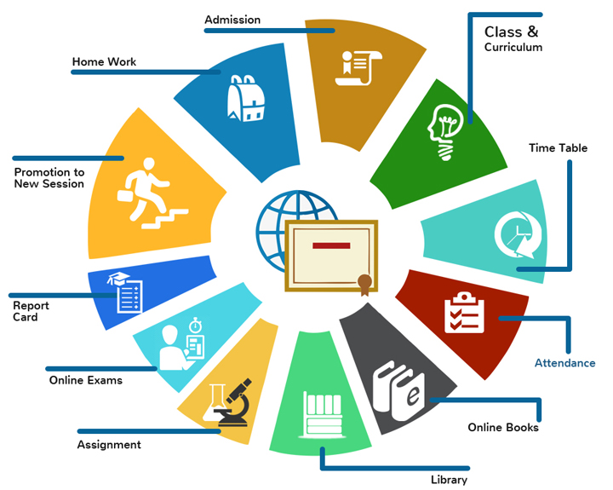
Core Modules:

Slide 13
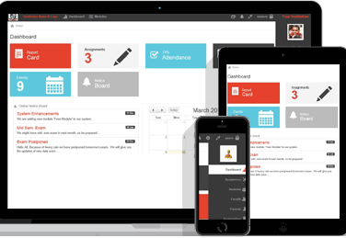
Software Dashboard
Dashboard reflects a well understood structure of the entire business
Shortcut keys, reminders, a well versatile handy information readily available
Information can be spread or notify to the users effortlessly
Can plan & manage tasks of the day in a well organized structure
Can be easily accessed by the mobile device
Can be customized according to the business needs
Personalized view to enjoy an ease in assigned task
Rated as the most resourceful feature
by the numerous users
Notifications of key performance
indicators

Slide 14


Admission Management
Admission formalities can be done in best organized way
Summarized report generation with complete admission details
Centralized data management process for multiple branches
Facilitate anywhere, anytime access and monitoring is trouble-free
Maintenance of transparency with student and parents
Admission receipt generation
Daily monetary collection report
Supervision of multiple branches by single login
Multi-located branched integration
Incorporation with enquiries management

Slide 15

Attendance Management
Biometric attendance management
Attendance by login facility with configured IP settings
Student wise attendance percentage (%) reports
Policies can be implemented in pre-structured surroundings
Maintenance of transparency with student and parents
Flexibility can be provided and administered
Error can be shunned
Saves time and labour with its unique automated system with multiple facilitation

Slide 16

Fee Management
Consolidated fee structure report for the entire course tenure
Automated Fee collection reminders
Online tracking of collections, pendency's, dues of fees in a most convenient way
Online fee submission via secured payment gateways
Transparency can be maintained and fraud transaction can be avoided
Fee structure can be customized according to the requirement
Amplify profits for the college by management of payments from alumni, donors and other contributors
Automatic backup's stored at multiple locations
Messages reminders via mails/sms to the students, parents regarding the pending payments and e-receipts

Slide 17

Courses Management
Management of course:- registration, affiliation, pre-requisites etc
Entire details of course structure to help students in planning of the study schedules
Pre-existing course content inclusive of summary, tenure, syllabus, important dates
Customized placement of course content
Integration with number of students in each course
Online delivery system of course content materials and course content package
Modifications, functionality and updation are auto generated
Online syllabus is the most effective way of alteration and communication of the
syllabus to the students
Completion tracking report can be viewed within the provided time frame
Upload or download syllabus options
Course books information with publisher details
Efficient multi user friendly environment

Slide 18

Faculty Management
Complete faculties activity reports
Faculty's credentials information
Daily work can be assigned to the faculties
Report against Task assigned with the scheduled timeline analytics
Secure eliminated data redundancy
Track missed lectures report
Efficiency generation reports analysis for improvement
Records of guest faculties
Remuneration records for variably payments to
the lecturers

Slide 19

Leave Management
Online leave applications approval/rejections with multiple gateways
Absolute "NO" to paper work as leave applications
Leave eligibility criteria allocated for different locations
Online leave account management system
Financial year leave summarized report
Leave policies overview for employees
Reports imports/export options
Setting leaves restriction days information
Productivity of organization can be increased by managing multiple staff absence for each department
Leave balance, history, usage can be analysed
Automatic sanction can be set for Senior Staff with notifications
to HR
Integrated with biometric attendance feature

Slide 20

Transportation Management
Centralized transportation management with ample visibility
Online organization of time charts, routes, drivers, bus numbers etc
Reports analysis and GPS tracking system
Messages can be send to the students regarding any modifications
Regular updates generation

Slide 21

Examination and Result
exams conductions via secured login's
Online results declaration
Complete student assessment reports for the entire tenure
Self evaluation assignments and questions paper
Examination and sets management
Well organized examination location and student distribution
Examination fee collection, fine collection, Payment mode reports
Secured and advanced multifaceted user interface from desired location
Cost saving and paper saving
Transparency of examination results for guardians
Grading assessment system integration

Slide 22

Library Management
Computerized design allows library staff to provide services easily and quickly
Excel Import/Export facility for easy maintenance of book records
Books category management
Comprehensive reports of issued, overdue, fine applicable, defaulters, circulation etc
Books are easily located within the racks
E-library members management
Books acquisition record and requirement
Subscriptions and membership management
Multi located library featured setup
High security and customized access rights can be managed
Additional features add-on's available
Barcode generation and printing facility
Restoration and data backup facility
Revenue collection via fine's, donations reports

Slide 23

Hostel Management
Hostel management software increase efficiency with minimal manpower requirements
Integration with admission module
Auto transfer information after selecting hostel checkbox while admissions
Software has facility of categorized allocation of rooms to the registered students
Complete record of food, logging, laundries and other facilities
Information can be circulated via one click SMS
Hostel expenses detailed report
All the information is accessible to the administrative department
Most efficient method to manage all the activities within the premises
Hostel fee payments reminders alert can be send through software
Hostel movement and activities reports

Slide 24
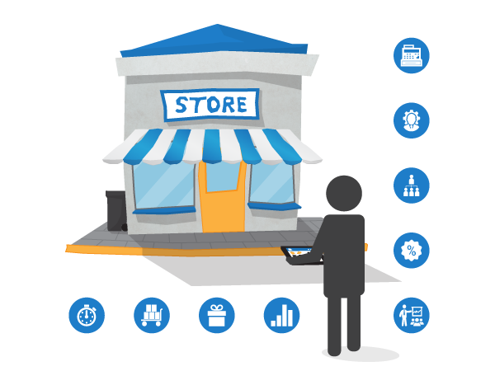
Store Management
Online record of available stock centralized for all branches
Online requisition form with multiple approval interfaces
Purchase order can be mailed directly
Auto stock updating on receipt of the ordered material
Highly designed and fully integrated advanced version
Customized category and material management
Accuracy in inventory orders and supplies
Increase in productivity & elimination of faults
Multiple functionalities setting for each department

Slide 25

Placement Management
Student batches details and important information storage
Documents and CV unload/Download options
Job Category Management
Email, SMS and Reminders facility
Complete data management and processing
Placement software has Inter-connectivity with result declaration
Placement ratio reports and pendency track report
Registered companies management in campus placements
Shortlisted and correspondence management
Pre placement and post placement activity manager

Slide 26

Employee & Student Panel
Employees can login into their accounts
Attendance, Leaves, personal information can be viewed and updated
Online grievances management system
A clear view of KRA's can be mentioned to be followed
Employee can submit their daily work done report
Online request form to save time and increase productivity
Online inductions programs for the better well organized environment
Outstanding for employee employer relations
Student login panel acts as a most important module in the software
Students can login to view the date sheet, results and other information
Import dates can be updated within enables the students to catch each activity
Student grievances can be handled without any hassle
Student can stay well conned with the college
Professional approach to manage student requirements

Slide 27
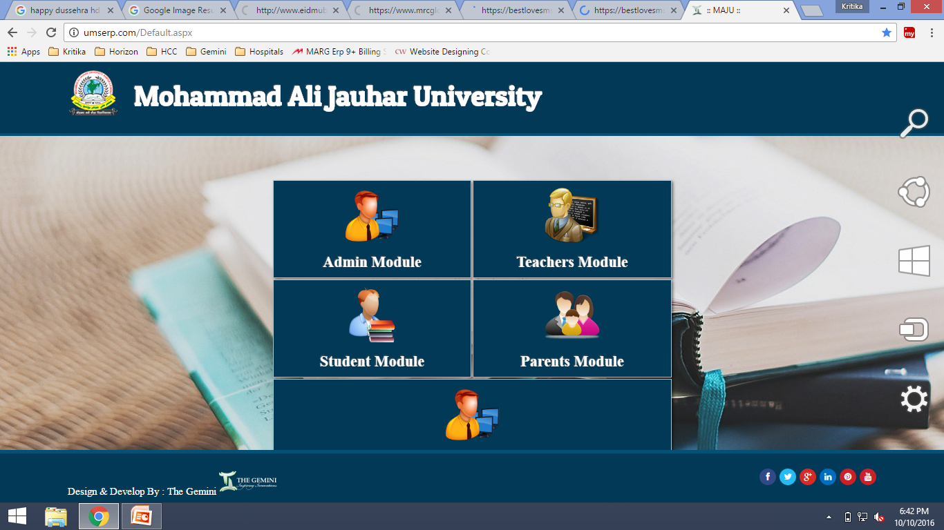

Slide 28
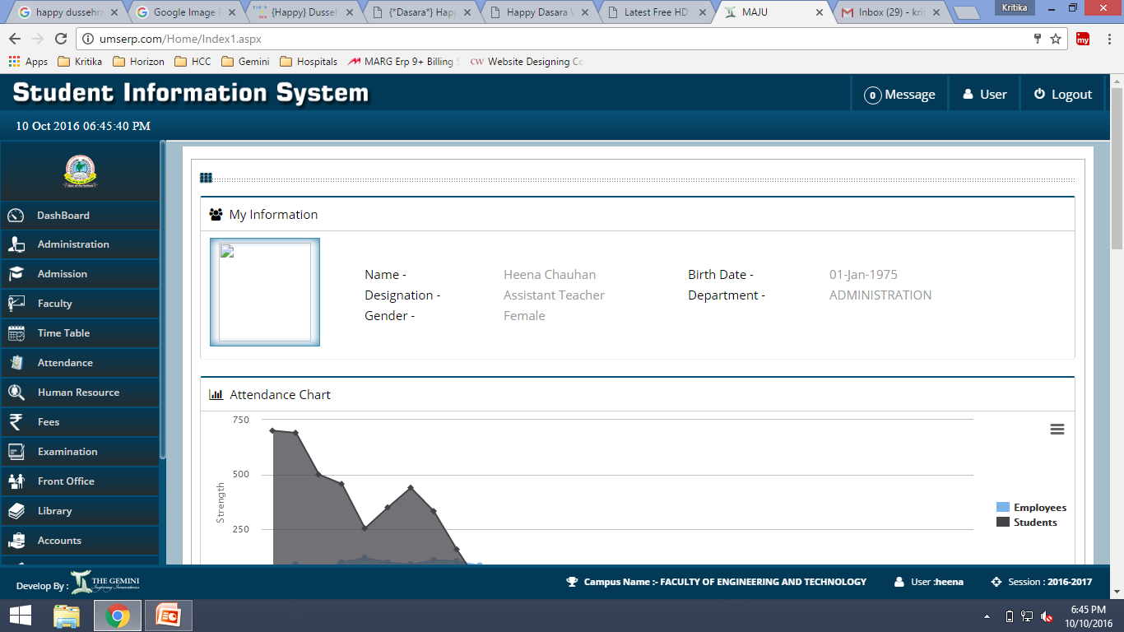

Slide 29
Get in touch with us today !
Phone: +91 9265562676 Mail : consultants@thegemini.co.in
www.thegemini.in

